Slide 1
Capstone Project
The Battle of Neighborhoods
Paris Restaurants
Lucas DA RIN

Slide 2
Agenda
Introduction
Data
Methodology
Results & Discussion
Conclusion
The Battle of Neighborhoods
Choice of theme
Neighborhoods in Paris
What’s the goal of this Project
Data to be used
Sources of data
Foursquare API
Challenges of this Project
Data Cleaning
Obtaining Data
The table of neighborhoods
Functions
Challenges of this Project
Data Cleaning
Results
Best and Most Popular Restaurants
Study of the neighborhoods
Discussion
Do the answers make sense?
Limitations of the model
Questions answered
Are french restaurants the most common ones in Paris?
What are best neighborhoods from the culinary point of view?
Which neighborhoods

Slide 3
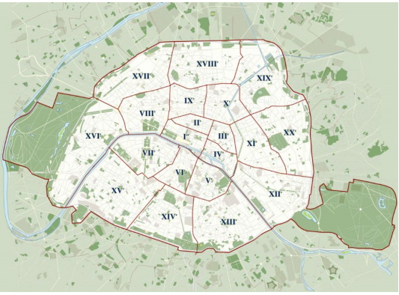
Introduction
Paris is one of the most important cities of the world when it comes to tourism, arts, fashion and culinary. This Project focuses on the culinary of the city;
Paris has 20 neighborhoods and the goal of this Project is examining how restaurants are distributed among them

Slide 4
Data
The data about the neighborhoods of Paris comes from the French Government (https://www.data.gouv.fr/);
The data contains geographic locations for each of the 20 neighborhoods of the city;
Some of the columns are not used in this Project.
Foursquare API
Data Sources
Foursquare API is the tool for finding venus given locations;
In this Project, the API is used for finding venues near the locations provided in the table;
Later on this Project the API is used to find clients’ opinions about the restaurants;

Slide 5
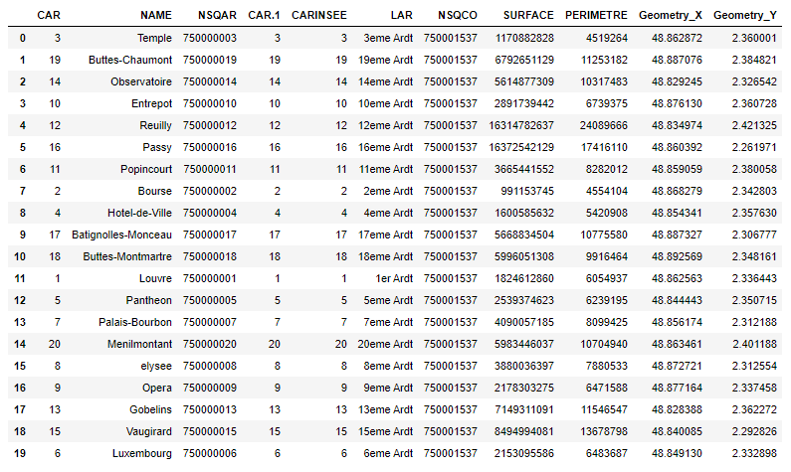
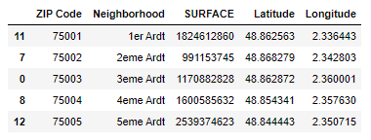
Data Cleaning
Many of the columns in the table on the left, provided by our source, are not used in this Project. For this reason some of them were dropped to arrive at the table form below, with the columns needed

Slide 6
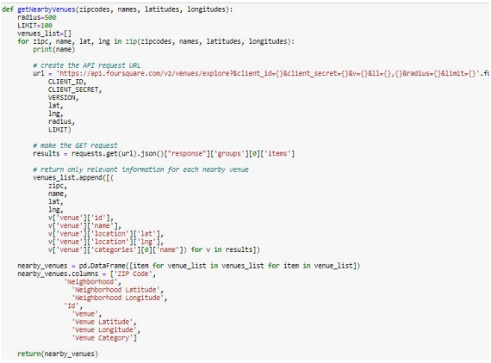
Methodology
This project consists of exploring venues around specific neighborhoods, using Foursquare API, investigating the ratings and popularity of venues and exploring the distribution of venues and their ratings across neighborhoods;
The venues were found after the definition of a function for finding 100 results in a radius of, at first, 500 meters, as shown on the right.

Slide 7
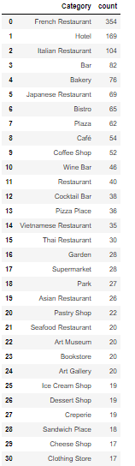
Methodology
The data about the neighborhoods comes in a csv(comma-separated values) file, consisting of the ZIP Code, Neighborhood Name and Geographical locations;
The venues found were treated in order to keep the most likely of the occurrences in cases of duplicates;
The data of the venues was then treated in order to keep only restaurants and bars.
List of types of venues

Slide 8
Methodology – Filtering Restaurants & Bars
The criteria chosen was to check for 35 most common kinds of venues and filtering out those that were not related to restaurants and bars or that could not fit in “French Restaurants”, “Italian Restaurants”, “Cafés & Bars” and “Asian Restaurants” categories;
The list consists of the following types of venues ['French Restaurant','Italian Restaurant', 'Japanese Restaurant', 'Bistro', 'Wine Bar','Coffee Shop','Café','Cocktail Bar','Bar','Vietnamese Restaurant','Asian Restaurant', 'Thai Restaurant', 'Creperie', 'Chinese Restaurant' ];
989 venues were found.

Slide 9
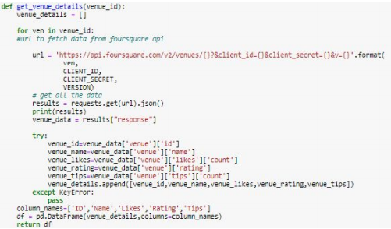
Methodology - ‘Rating’, ‘Likes’ and ‘Tips’
A function using Foursquare API was defined for extracting ‘Rating’, ‘Likes’ and ‘Tips’ fields;
The merging of the venues details table and the entire list of venues was then used for the analysis of distribution or rates and geographical distribution of the venues;
The results and discussion of the investigation are presented in the ‘Results’ and ‘Discussion’ sections.

Slide 10
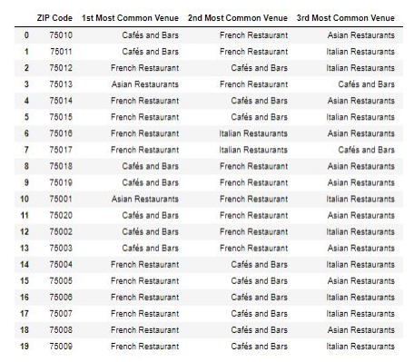
Results
The results show that French Restaurants are the most popular ones in 11 of the 20 neighborhoods of Paris, while Cafés & bars and Asian Restaurants account for 7 and 2 neighborhoods, respectively;
Café de Flore is the most popular one and La Cave de Septime is the best restaurant of our sample;
3ème neighborhood is the one with the best ratings, while 12ème and 20ème have average ratings below 7;

Slide 11
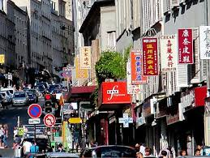
Discussion
The results show that French restaurants, followed by cafés and bars are the most common venues in 18 of the 20 neighborhoods;
This first result is no surprise, since French restaurants are probably the most common ones in France;
On the other hand, the 1st and the 13th neighborhoods have more Asian Restaurants than French and Bars, which makes sense, since the Japanese area and the Asian area are located in these neighborhoods respectively;
Quartier Asiatique. Source: Le Routard (routard.com)

Slide 12
Discussion – Limitations of the model
The model created for this project uses a sample of the venues found in Paris and it does not intend to represent with perfect accuracy the reality;
The analysis of the best restaurant and the most popular one may be somehow compromised, since not all of the restaurants are in our sample;
The number of results in the sample of the project is limited by the API quota, the number of restaurants and bars, 989, is the best one to be reached within the limits of the API quota;

Slide 13
Conclusion
This study concludes that french restaurants are most common ones in 11 of the 20 neighborhoods of Paris, followed by cafés and bars;
Another interesting point is that the 13th and the 1st shows more asian restaurants than any category of restaurant in our sample;
Another interesting conclusion is that most neighborhoods have no significant difference in their average rating, while 12ème and 20ème classify by far as the least appealing neighborhoods in clients’ opinion.

